Slide 1
Data Stuctures and Algorithms
Dr. Fidaa Abed

Slide 2
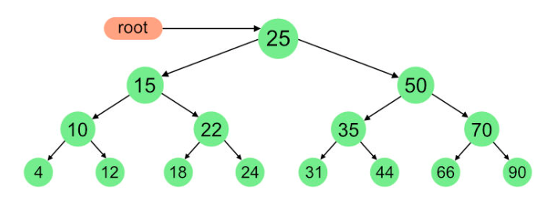
Binary Trees Traversal
InOrder traversal:
Visit the left part
Visit the root
Visit the right part

Slide 3

Binary Trees Traversal
InOrder traversal:
Visit the left part
Visit the root
Visit the right part

Slide 4
Binary Trees Traversal
PreOrder traversal:
Visit the root
Visit the left part
Visit the right part

Slide 5

Binary Trees Traversal
PreOrder traversal:
Visit the root
Visit the left part
Visit the right part

Slide 6
Binary Trees Traversal
PostOrder traversal:
Visit the left part
Visit the right part
Visit the root

Slide 7

Binary Trees Traversal
PostOrder traversal:
Visit the left part
Visit the right part
Visit the root

Slide 8
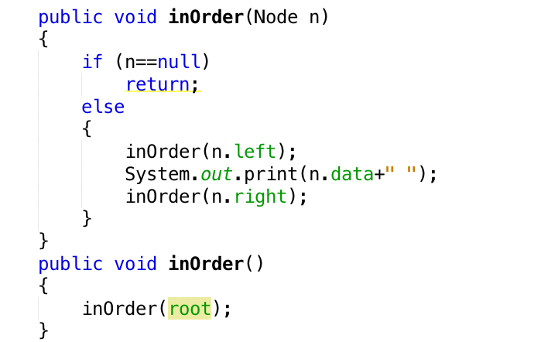
Binary Trees Traversal

Slide 9
Excercise
Implement the three traversal methods
InOrder, PreOrder, and PostOrder
Write a recursive method that sums all the integer values stored in the nodes in the binary trees. Test this method.
Construct the tree that has the following:
Inorder sequence: D B E A F C
Preorder sequence: A B D E C F

